Slide 1

Enhancing Institutional Teaching Culture Based on Evidence:
Indicators, Perceptions and Recommendations
Erika Kustra, Ken N. Meadows, Paola Borin, Lindsay Shaw
May 3, 2017
University of Windsor-Oakland University International Teaching and Learning Conference

Slide 2

Agenda
What is teaching culture?
Why do we care?
How would you know if a culture values teaching?
Teaching Culture Perspectives Survey (TCPS)
What are Effective Practices to enhance a teaching culture?

Slide 3


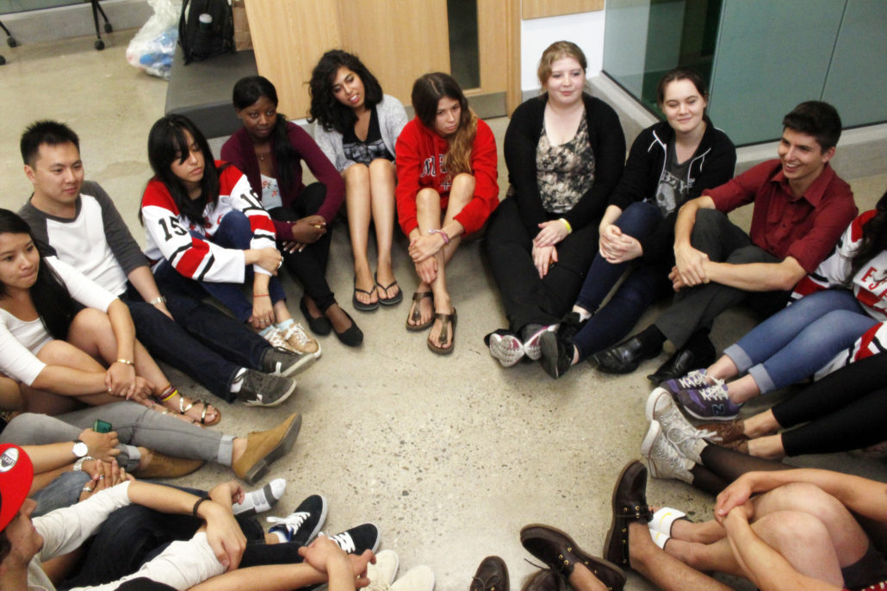
What is a teaching culture?

Slide 4
What is a Teaching Culture?
Institutional culture: embedded patterns, behaviours, shared values, beliefs, and ideologies which help define educator and learner experiences, and can have numerous micro-cultures
(Cox et al., 2011; Kustra et al. 2014; Mårtensson & Roxå, 2016)
Teaching culture: an institutional culture demonstrating teaching is valued (Kustra et al, 2014)

Slide 5
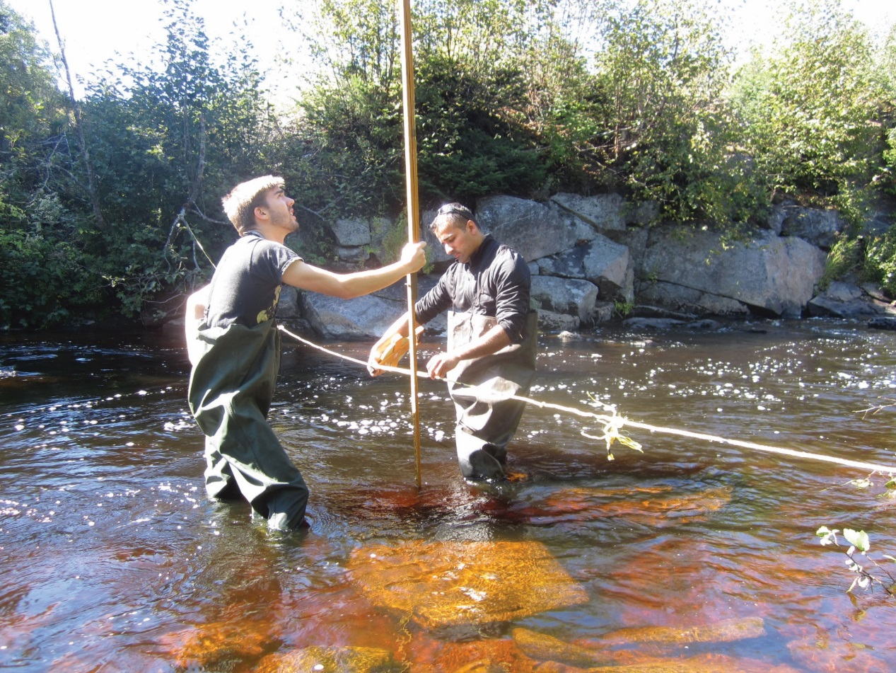


Why does a Teaching Culture Matter?
Discuss in small groups of 3-4.

Slide 6
Why does a Teaching Culture Matter?
Contributes to a shared campus commitment to teaching excellence
Impacts student learning, student engagement, and student retention
Influences faculty motivation and behavior
Impacts finances
Berger & Braxton, 1998; Bergquist & Pawlak, 2008;
Cox et al., 2011; Feldman & Paulsen, 1999; Grayson & Grayson, 2003

Slide 7
How would you know if a teaching culture valued teaching?

Slide 8
A culture that values teaching has:
A shared campus commitment to teaching
Meaningful and constructive evaluation of teaching
Broad engagement (students, faculty, stakeholders)
Hiring and promotion practices related to teaching
Infrastructure
Support for teacher development
Teachers who use good practices
Recognition of good teaching
Opportunities to develop teaching leadership
Institutional policies to foster quality teaching
Regular assessment of impact for improvement
(Henard & Roseveare, 2012; Kustra, et al, 2014 and 2015; Paulsen & Feldman, 1995)

Slide 9
Teaching Culture Perception Survey
Survey developed from framework of institutional indicators that support quality teaching
Intended to assess perceptions of institutional teaching culture for different stakeholder groups
Notes:
KM
3 versions of the survey have been created. The instructor and student surveys have been tested at 4 universities in addition to UW, and the staff version is the newest, with having only been tested at 1 other institution.
The current focus of the study is validating the measures.

Slide 10
Teaching Culture Perception Survey
3 versions of the survey
  Instructors (37 items)
  Students (undergraduate & graduate; 31 items)
  Staff who support teaching & learning (33 items)
Notes:
KM
3 versions of the survey have been created. The instructor and student surveys have been tested at 4 universities in addition to UW, and the staff version is the newest, with having only been tested at 1 other institution.
The current focus of the study is validating the measures.

Slide 11
Teaching Culture Perception Survey
“At my institution, teaching is considered a priority in the
primary institutional strategic plan”
Items rated twice:
To what extent do you agree or disagree with the following statements? Strongly disagree (1) to Strongly Agree (5)
Rate the importance of the following characteristics to you. Not at all important (1) to Very important (5)
Notes:
KM
For each item, respondents answer 2 scales: the degree to which they agree with the statement and the importance of the statement. Respondents could also answer “I don’t know”, but these responses were not used in the substantive calculations.
This gives us a sense of how respondents view what is currently happening on campus as well as how they value the characteristic. Essentially, how the campus is doing and what respondents feel is the “ideal”.

Slide 12
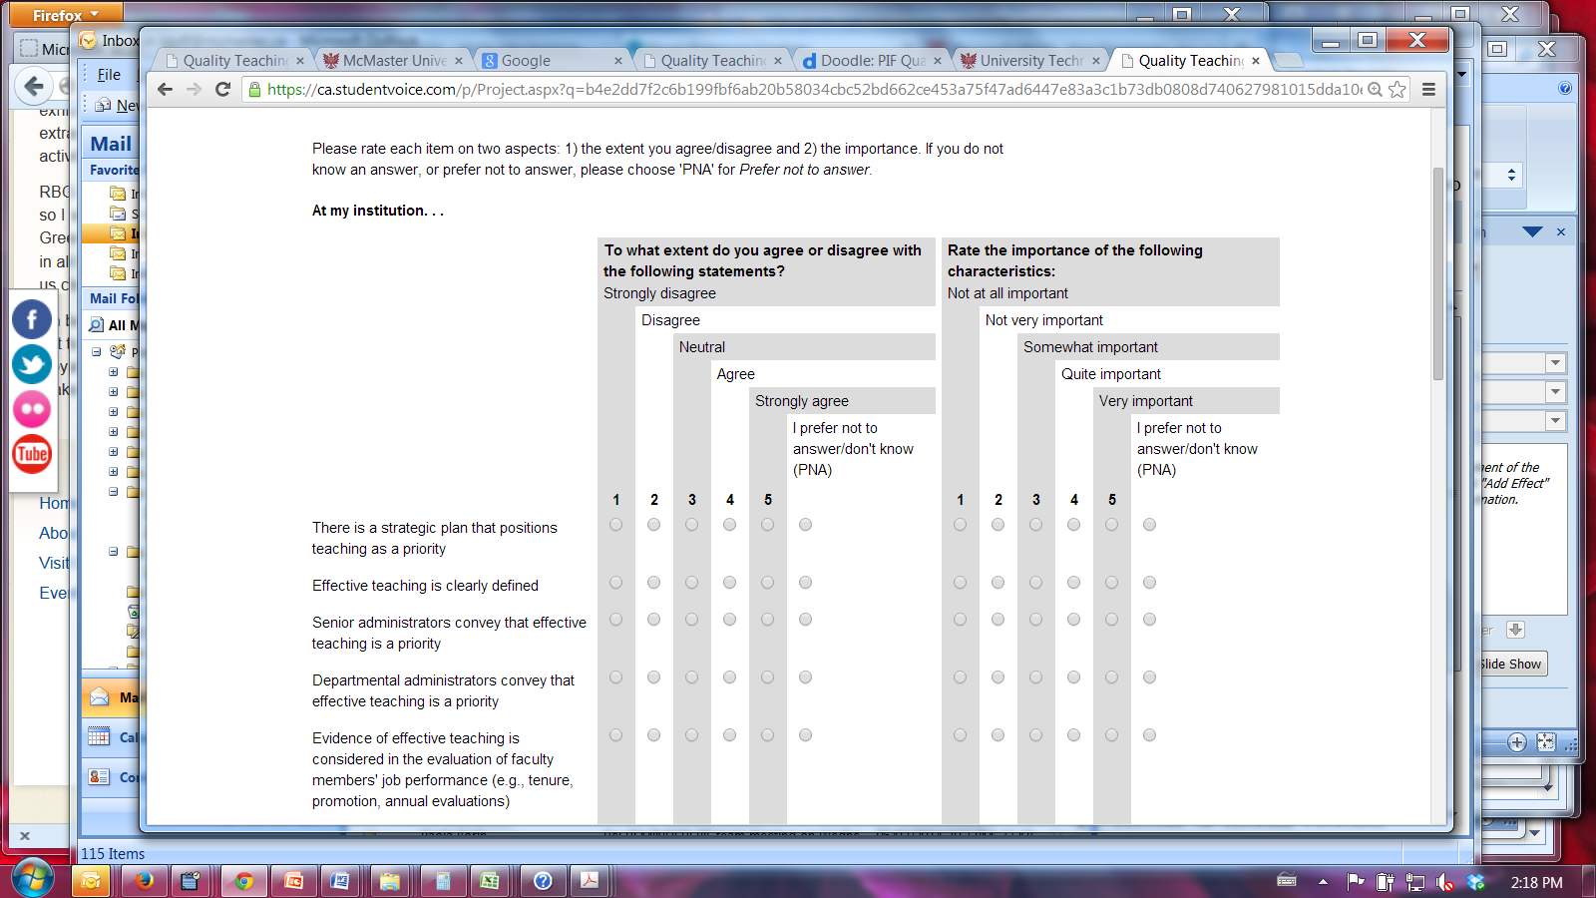
Teaching Culture Perception Survey (TCPS)

Slide 13
Teaching Culture Perception Survey
1
Institutional, strategic initiatives & practices prioritize effective teaching
2
Assessment of teaching is constructive & flexible
3
Implementing effective teaching
4
5
Infrastructure exists to support teaching
6
Broad engagement around teaching
Effective teaching is recognized & rewarded
Calculate mean of all items for each lever:
Agreement
Importance
Notes:
KM
There are 6 levers within the surveys; each made up of several items. The themes represented by the items are included in your handout. Items differ between the 3 participant groups.
We then calculate a mean of the scores for all items within each lever for both scales (agreement & importance).

Slide 14
TCPS Activity
 | Faculty |  | Students |  | Staff
 | Sessional | Full-time | Undergraduate | Graduate
Lever 1
Agreement¹ | 3.04 (0.89) | 3.26 (0.85) | 3.47 (0.80) | 3.47 (0.84) | 3.51 (0.64)
Importance² | 4.42 (0.58) | 4.02 (0.84) | 4.44 (0.55) | 4.41 (0.58) | 4.64 (0.41)
Lever 2
Agreement | 2.87 (0.84) | 2.84 (0.67) | 3.14 (0.79) | 3.15 (0.84) | 2.42 (0.86)
Importance | 4.21 (0.51) | 3.90 (0.65) | 4.21 (0.62) | 4.16 (0.68) | 3.94 (0.73)
Lever 3
In groups of 3-4, take 10-minutes to develop a
Each group will present their 2 choices of levers and why they chose those elvers

Slide 15
TCPS Activity
In groups of 3-4:
take 10-minutes to review your section of the table (e.g., sessional faculty) and
decide which two levers you would target to enhance the teaching culture at the institution, and why.
After 10 minutes, each group will present their 2 levers and why they chose those levers

Slide 16

Effective Practices to Enhance Teaching Culture
Gallery Walk

Slide 17
Effective Practices to Enhance Teaching Culture Gallery Walk
Choose one of the six levers you are interested in (form a new group at the chart).
Brainstorm effective practices that would help promote that lever.
Indicate what the suggestions are based on (eg. cases, research, theory, logic, etc.).
  Record ideas on the flipchart paper
  Take about 7 minutes

Slide 18
Effective Practices to Enhance Teaching Culture Gallery Walk
Rotate to the next lever.
Add to the ideas on the flipchart paper

Slide 19
Effective Practices to Enhance Teaching Culture Gallery Walk
Take a Gallery Walk to look at the other levers!
  about 5 minutes

Slide 20

Summary
What is teaching culture?
Why do we care?
How would you know if a culture values teaching?
Teaching Culture Perspectives Survey (TCPS)
Effective Practices

Slide 21

Reflection
What ideas might be useful for you, or your area/institution?

Slide 22


Thank you!
Erika Kustra (kustraed@uwindsor.ca)
Ken N. Meadows (kmeadow2@uwo.ca)
Paola Borin (borin@ryerson.ca)
Lindsay Shaw (shaw11r@uwindsor.ca)

