Slide 1









Leading Educational Change through Documenting and Transforming Institutional Teaching Culture
Florida Doci.
Kaitlyn Gillard.
Hoda Eiliat.
Erika Kustra.
Windsor-Oakland 2015

Slide 2
Session Overview
Background
Indicators of teaching culture
Teaching culture perceptions
Next steps and conclusions

Slide 3
The Political Terrain in Ontario
Metrics, metrics, metrics
Productivity and Innovation
Differentiation
Strengthening
centres of creativity innovation and knowledge
Strategic Mandates
Notes:
What we’re up against in Ontario

Slide 4
The value that institutions
place on teaching is
important to us
The value that institutions
place on teaching is
important to us
We aim to contribute to fostering an
institutional culture that values quality teaching
Notes:
Fundamental premises behind our work
Lori [from EDC session]
With this slide shown, we can mention that we’ve been creating a survey that will help us understand and document the culture (or the perceptions, beliefs, and behaviours that people within an institution have) and how extensively (quality) teaching is valued.
Then, we can transition into why this is important within the political terrain in Ontario.

Slide 5
What Do We Mean by Teaching Culture?
Organizational culture: Deep structure of an organization, rooted in organizational members’ values, beliefs, and assumptions (Denison, 1996)
We believe:
Foster quality teaching by developing an institutional culture that values teaching
Culture influences whether people are able to be successful as educational leaders
Notes:
Assumptions [from EDC session]
In higher education, organizational behaviour theory suggests that professors’ behaviors will reflect their institutional and departmental culture, which implies that improving the culture of teaching will have an effect on student experience (Cox, McIntosh, Reason & Terenzini, 2011). There is evidence to suggest that organizational culture positively influences outcomes such as student persistence (Berger & Braxton, 1998; Berger & Milem, 2000).
FROM ORIGINAL SLIDE: A quality teaching culture, as we attempt to define it, is the set of institutional perceptions, behaviours, and norms that suggest quality teaching is valued
Erika

Slide 6
Overall Project Focus
Evidence & enhance
institutional teaching culture
at post-secondary institutions
    through
  direct feedback from constituents
    and
    key institutional indicators
    in order to
    provide concrete feedback and recommendations for continuous improvement
Notes:
[from EDC session]
The focus for this project is the value an institutional culture places on quality teaching. Improved organizational culture is tied to increases in productivity, performance, commitment and satisfaction in evidence drawn from the Business and Organizational Change Management literature (Barney, 1986; Saffold, 1988; Schein, 1992; Cameron & Quinn, 1999; Lok & Crawford, 2004). While culture contributes to the success of an organization, not all dimensions contribute equally (Denison, Daniel & Haaland, 2004). Labor cost advantages can be found in organizations with clearly codified cultures through becoming well known as more desirable places to work (Heskett, Sasser, & Wheeler, 2008). Attraction to the culture and structure of an organization is at the root of managing employee retention (Sheridan, 1992). Further, because turnover of faculty in higher education is likely much more costly than that of employees in the corporate environment due to institutional investment in start-up costs (i.e. laboratories), it is desirable to retain highly productive academics. Such a focus on retaining newly recruited faculty will contribute to a cycle of excellent research outputs and teaching excellence (Simmons, 2002).
Organizations with engaged workforces tend to have higher retention rates, increased customer satisfaction, and are more financially productive and profitable (Harter, Schmidt & Keyes, 2002). Engagement mediates the relationship between culture and performance, as is also suggested in the literature on student engagement (Skinner, Wellborn & Connell, 1990).
Pb

Slide 7
Anticipated Project Outcomes
Develop a survey instrument that identifies and provides evidence of prevailing perceptions
Identify key institutional indicators to triangulate and confirm teaching culture
Develop a report template with a recommendation package to help institutions choose practices that enhance their teaching culture
Notes:
Pb

Slide 8

Indicators- Definition
Indicators are signals that reveal the progress or lack of progress towards a specific objective. (Chalmers 2008)
Input Indicators
Quantity Indicators
Output Indicators
Indicators
Outcome Indicators
Quality Indicators
Process Indicators

Slide 9
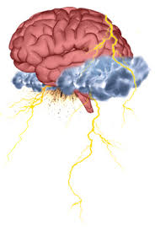
Indicators of Teaching Cultures
Brainstorm a list of measures or indicators that might be suggestive of a teaching culture.
Instructions (Part A)
One idea per post-it note please!
3-4 post-it notes each!
Instructions (Part B)
Post each idea on the wall
Arrange post-it notes into themes
Image Source: http://www.google.ca/imgres?imgurl=http://img.ezinearticles.com/blog/brainstorm.jpg&imgrefurl=http://blog.ezinearticles.com/2011/09/add-laser-focus-to-your-article-writing-process.html&h=372&w=250&tbnid=vyw5Mlm9_0Ih4M:&zoom=1&docid=Gw1H4enxutEOzM&ei=QP9PVZbUJ4SFyQTa2oHwBw&tbm=isch&ved=0CEIQMyg6MDo4yAE. Lastly viewed on May 9, 2015.

Slide 10
Identification and Validation of Indicators
Quantity Indicators
Input Indicators: Resources involved in supporting an institutional program, activity or service.
Output Indicators: Reflect the quantity of outcomes, including measurable results and direct consequences of the activities implemented. (Burke, 1998)
Notes:
Input: Enrollment rates, resources & infrastructure, support services, expenditures etc
Output: Retention rate, success rate, graduation rate, graduate full-time employment etc
Outcome: Graduate satisfaction, employer satisfaction, graduate competencies, learning outcomes, student literacy level etc
Process: Student experience, professional development, teaching and learning plans and policies, appointment and promotion criteria, assessment and feedback policies etc

Slide 11
Identification and Validation of Indicators
Quality Indicators
Outcome Indicators: Focus on the quality of educational program, activity and service benefits for all stakeholders. (Warglien & Savoia, 2001)
Process Indicators: Means used to deliver educational programs, activities and services within the institutional environment. (Burke, 1998)
Notes:
Input: Enrollment rates, resources & infrastructure, support services, expenditures etc
Output: Retention rate, success rate, graduation rate, graduate full-time employment etc
Outcome: Graduate satisfaction, employer satisfaction, graduate competencies, learning outcomes, student literacy level etc
Process: Student experience, professional development, teaching and learning plans and policies, appointment and promotion criteria, assessment and feedback policies etc

Slide 12
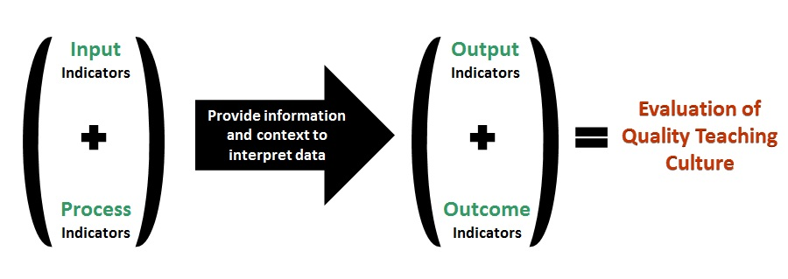
Indicators & Evaluation of Teaching Culture
Process indicators are the most practical, useful and appropriate measures of quality teaching and learning (culture) within higher education institution. (Chalmers and Thomson 2008)

Slide 13
Teaching Culture Perception Survey
Aimed at examining the perceptions to develop a profile, allowing comparison between different stakeholders’ perceptions & comparison of change over time.
Questions designed to identify and validate indicators of quality teaching culture on campus.
Questions designed to represent five revised levers
Notes:
These levers were first identified by Henard and Roseveare (2012), initially as a basis for sharing effective practices across institutions, as well as to emphasize the idea that improving a teaching culture does not necessarily involve or require a significant monetary investment. These revised levers represent the overarching themes that provide concrete ways to foster quality teaching in higher education.

Slide 14
Levers Included in the TCPS
Lever 1: Teaching is recognized in institutional strategic initiatives & practices (10 items)
Lever 2: Assessment of teaching is constructive and flexible (7 items)
Lever 3: Faculty are encouraged to develop as teachers (8 items)
Lever 4: Infrastructure exists to support teaching (6 items)
Lever 5: Broad engagement around teaching occurs (8 items)
Notes:
These levers were first identified by Henard and Roseveare (2012), initially as a basis for sharing effective practices across institutions, as well as to emphasize the idea that improving a teaching culture does not necessarily involve or require a significant monetary investment. These revised levers represent the overarching themes that provide concrete ways to foster quality teaching in higher education.

Slide 15
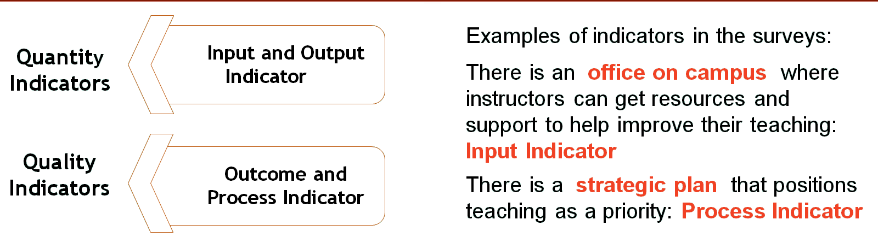
Use of Indicators on TCPS
Examining the perceived existence (agreement ratings) and importance (importance ratings) of certain indicators related to quality teaching to develop a profile of the culture in the institution.
Triangulation of perception and facts
Notes:
So back to indicators, as we mentioned they are signals that reveal progress or lack of

Slide 16
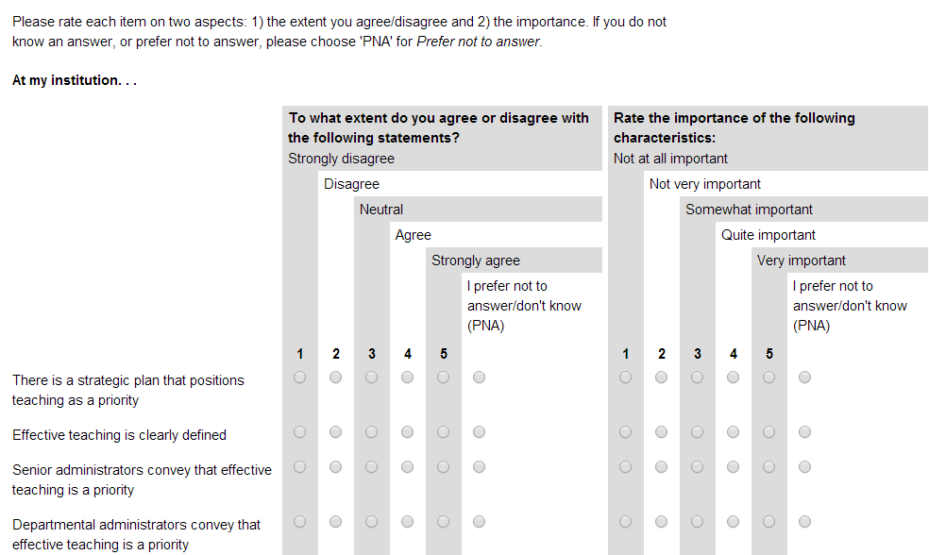
Teaching Culture Perception Survey (TCPS)
Assessment of agreement and importance ratings

Slide 17
Teaching Culture Perception Survey & Focus Groups
Two versions of the survey
  Students: Graduate & undergraduate
  Faculty & Administration
Pilot survey at three Ontarian institutions
  Windsor ( 921 participants)
  Western (1589 participants)
  McMaster (1334 participants)
Focus groups ran to collect feedback
on the survey and input on quality
teaching culture at each institution.
Faculty & Administration

Slide 18
PRELIMINARY RESEARCH FINDINGS
 | Agreement | Importance
Faculty | 1) Recognizing effective teaching (3.57) | 1) Recognizing effective teaching (4.08)
 | 2) Broad involvement around teaching (2.94) | 2) Assessing teaching (4.00)
 | 3) Encouraging effective teaching (2.91) | 3) Encouraging effective teaching (3.82)
 | 4) Assessing teaching (2.60)
Undergraduate Students | 1) Accessing infrastructure (3.70) | 1) Prioritizing effective teaching (4.44)
 | 2) Recognizing effective teaching (3.69) | 2) Accessing infrastructure (4.32)
 | 3) Implementing effective Teaching (3.21) | 3) Implementing effective teaching (4.30)
 | 4) Broad involvement around teaching (2.96) | 4) Providing feedback on teaching (4.24)
 |  | 5) Broad involvement around teaching (3.76)
 |  | 6) Recognizing effective teaching (3.66)
Graduate Students | 1) Accessing infrastructure (3.74) | 1) Accessing infrastructure (4.31)
 | 2) Recognizing effective teaching (3.54) | 2) Implementing and enhancing effective teaching (4.21)
 | 3) Fostering and implementing effective teaching (3.23) | 3) Recognizing effective teaching (4.21)
 |  | 4) Broad involvement around teaching (3.54)

Slide 19
Pilot Study Qualitative Results
Noted indicators of a teaching culture that values teaching:
Students
Faculty
Current and supported best practices
Professors’ behavior
Teacher accessibility
Valid assessment tools
Implementation of student feedback
Support for teaching
Recognition of teaching
Support for teaching
Recognition of teaching
Infrastructure
Research above teaching
Teaching evaluations
Notes:
Comments and examples for each point

Slide 20
Next Steps…
Develop version of survey for staff who support teaching and learning
Validate and establish norms for the surveys
Expand focus of research (e.g., outside Ontario, include colleges)
Develop manual with recommendations to improve institutional teaching cultures
Notes:
The overall project is an important long term change management opportunity. Following completion of the formal proposed project, we plan to continue with focus groups to assess the face validity of the QCPI tool and indicators and to gather feedback about the process and utility of the report received. This portion of the project will be funded through other sources and in kind support.
Erika 30 secs

Slide 21
Conclusions…
  Project goal to foster institutional cultures that value quality teaching, which, ideally, translates into improved teaching and learning
  Creating ways for institutions to evaluate their teaching culture (TCPS, indicators), determine areas for improvement, and use recommended strategies to realize improvements
  Create environment that enables change and effective educational leadership.
Notes:
The overall project is an important long term change management opportunity. Following completion of the formal proposed project, we plan to continue with focus groups to assess the face validity of the QCPI tool and indicators and to gather feedback about the process and utility of the report received. This portion of the project will be funded through other sources and in kind support.
Erika 30 secs

Slide 22
Research team
Paola Borin (Ryerson University)
Deb Dawson (University of Western Ontario)
Florida Doci (University of Windsor)
Donna Ellis (University of Waterloo)
Lori Goff (McMaster University)
Jill Grose (Brock University)
Sandy Hughes (Laurier University)
Erika Kustra (University of Windsor)
Ken Meadows (University of Western Ontario)
Peter Wolf (University of Guelph/ Queens University)
Acknowledgement: MTCU Productivity Innovation Fund grant

Slide 23
Erika Kustra: kustraed@uwindsor.ca
Florida Doci: docif@uwindsor.ca
Kaitlyn Gillard: gillard@uwindsor.ca
Hoda Eiliat: eiliat@uwindsor.ca
Website: uwindsor.ca/teachingculture
QUESTIONS

Slide 24
References
  ● Burke, J. C. (1998). Performance Funding Indicators: Concerns, Values, and Models for State Colleges and Universities. New Directions for Institutional Research, 97, 49-60.
● Chalmers, D. (2008). Teaching and Learning Quality Indicators in Australian Universities, Conference proceedings of Institutional Management in Higher Education (IMHE), Paris France, September 8-12.
● Chalmers, D. & Thomson, K. (2008). Snapshot of Teaching and Learning Practice in Australian Higher Education Institutions. Carrick Institute for Learning and Teaching in Higher Education Ltd, Sydney, NSW.
● Denison, D. R. (1996). What is the Difference Between Organizational Culture and Organizational Climate? A Native’s Point of View on a Decade of Paradigm Wars. Academy of Management Review, 21(3), 619-54.
● Hénard, F. & Roseveare, D. (2012). Fostering Quality Teaching in Higher Education: Policies and Practices. France: Organization for Economic Co-operation and Development.
● Warglien, M., & Savoia, M. (2001). Institutional Experiences of Quality Assessment in Higher Education -The University of Venice (Italy). Organization for Economic Cooperation and Development (OECD).

