Slide 1

Teaching Culture Indicators Survey
Leading Educational Change through Documenting and Transforming Institutional Teaching Culture
.
Bright Ideas
Teaching and Learning National Institute
2016.

Slide 2
Session Overview
Background
Indicators of teaching culture
Teaching culture perceptions project
Next steps and conclusions

Slide 3
The Political Terrain in Ontario
Productivity and Innovation
Metrics, metrics, metrics
Differentiation
Strategic Mandates
Notes:
What we’re up against in Ontario
Have increasing demands to find metrics that account for the quality of student learning and teaching, yet many of the currently available metrics focus on inputs and outputs.

Slide 4










The value that institutions
place on teaching is
important
Notes:
Wanted a metric that might help improve the Teaching Culture of an institution

Slide 5
What Do We Mean by Teaching Culture?
Organizational culture: Deep structure of an organization, rooted in organizational members’ values, beliefs, and assumptions (Denison, 1996)
Embedded patterns, behaviours, shared values, beliefs, and ideologies of an educational institution, which help define educator and learner experiences.
Notes:
Institutional culture consists of the embedded patterns, behaviours, shared values, beliefs, and ideologies of an educational institution, which help define educator and learner experiences. Research suggests that university teaching culture can positively influence critical outcomes such as student learning (Cox, McIntosh, Reason, & Terenzini, 2011), student engagement (Grayson & Grayson, 2003), and student persistence (Berger & Braxton, 1998).
In higher education, organizational behaviour theory suggests that professors’ behaviors will reflect their institutional and departmental culture, which implies that improving the culture of teaching will have an effect on student experience (Cox, McIntosh, Reason & Terenzini, 2011). There is evidence to suggest that organizational culture positively influences outcomes such as student persistence (Berger & Braxton, 1998; Berger & Milem, 2000).
FROM ORIGINAL SLIDE: A quality teaching culture, as we attempt to define it, is the set of institutional perceptions, behaviours, and norms that suggest quality teaching is valued
Erika

Slide 6
Your culture?
What kind of teaching culture do you see at your institution?
What patterns of behavior or shared values would you be a signal of a positive teaching culture?

Slide 7
Why Do We Care About Teaching Culture?
Research suggests university teaching culture can positively influence:
  student learning (Cox, McIntosh, Reason, & Terenzini, 2011)
  student engagement (Grayson & Grayson, 2003)
  student persistence (Berger & Braxton, 1998)
  professors’ behaviors (Cox, McIntosh, Reason & Terenzini, 2011)
Foster quality teaching by developing an institutional culture that values teaching
Notes:
Institutional culture consists of the embedded patterns, behaviours, shared values, beliefs, and ideologies of an educational institution, which help define educator and learner experiences. Research suggests that university teaching culture can positively influence critical outcomes such as student learning (Cox, McIntosh, Reason, & Terenzini, 2011), student engagement (Grayson & Grayson, 2003), and student persistence (Berger & Braxton, 1998).
In higher education, organizational behaviour theory suggests that professors’ behaviors will reflect their institutional and departmental culture, which implies that improving the culture of teaching will have an effect on student experience (Cox, McIntosh, Reason & Terenzini, 2011). There is evidence to suggest that organizational culture positively influences outcomes such as student persistence (Berger & Braxton, 1998; Berger & Milem, 2000).
FROM ORIGINAL SLIDE: A quality teaching culture, as we attempt to define it, is the set of institutional perceptions, behaviours, and norms that suggest quality teaching is valued
Erika

Slide 8

Culture eats strategy for breakfast.
Every time.
- Drucker
With thanks to Bev Hamilton!

Slide 9
Project Outcomes
Develop a survey that identifies prevailing perceptions of the teaching culture
Working to:
Develop a report template with a recommendation package to help institutions choose practices that enhance their teaching culture
Identify key institutional indicators to triangulate and confirm teaching culture
Notes:
Pb

Slide 10

Indicators- Definition
Indicators are signals that reveal the progress or lack of progress towards a specific objective. (Chalmers 2008)
Input Indicators
Quantity Indicators
Output Indicators
Indicators
Process Indicators
Quality Indicators
Outcome Indicators

Slide 11
Identification and Validation of Indicators
Quantity Indicators
Input Indicators: Resources involved in supporting an institutional program, activity or service.
Output Indicators: Reflect the quantity of outcomes, including measurable results and direct consequences of the activities implemented. (Burke, 1998)
Notes:
Input: Enrollment rates, resources & infrastructure, support services, expenditures etc
Output: Retention rate, success rate, graduation rate, graduate full-time employment etc
Outcome: Graduate satisfaction, employer satisfaction, graduate competencies, learning outcomes, student literacy level etc
Process: Student experience, professional development, teaching and learning plans and policies, appointment and promotion criteria, assessment and feedback policies etc

Slide 12
Identification and Validation of Indicators
Quality Indicators
Process Indicators: Means used to deliver educational programs, activities and services within the institutional environment. (Burke, 1998)
Outcome Indicators: Focus on the quality of educational program, activity and service benefits for all stakeholders. (Warglien & Savoia, 2001)
Notes:
Input: Enrollment rates, resources & infrastructure, support services, expenditures etc
Output: Retention rate, success rate, graduation rate, graduate full-time employment etc
Outcome: Graduate satisfaction, employer satisfaction, graduate competencies, learning outcomes, student literacy level etc
Process: Student experience, professional development, teaching and learning plans and policies, appointment and promotion criteria, assessment and feedback policies etc

Slide 13
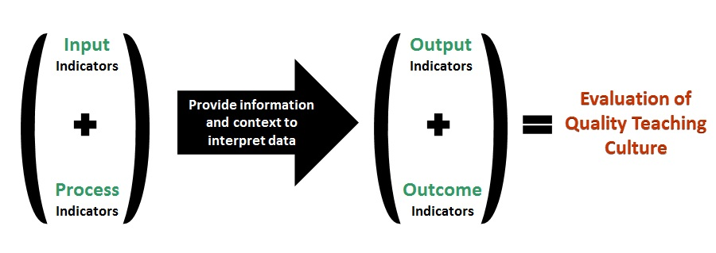
Indicators & Evaluation of Teaching Culture
Process indicators are the most practical, useful and appropriate measures of quality teaching and learning (culture) within higher education institution. (Chalmers & Thomson, 2008)
Figure Developed by Hoda Eiliat

Slide 14
Teaching Culture Perception Survey
Aimed at examining the perceptions to develop a profile, allowing comparison between different stakeholders’ perceptions & comparison of change over time.
Questions designed to identify and validate a mix of the four types of indicators of quality teaching culture on campus.
Questions designed to represent six levers
Notes:
These levers were first identified by Henard and Roseveare (2012), initially as a basis for sharing effective practices across institutions, as well as to emphasize the idea that improving a teaching culture does not necessarily involve or require a significant monetary investment. These revised levers represent the overarching themes that provide concrete ways to foster quality teaching in higher education.

Slide 15
Levers Included in the TCPS
Based on model developed by Hénard & Roseveare (2012)
Modified for Canadian context, and refined based on statistical analysis of survey and focus group feedback from three institutions
  Lever 1: Institutional, strategic initiatives & practices
  prioritize effective teaching
  Lever 2: Assessment of teaching is constructive and flexible
  Lever 3: Implementing effective teaching
  Lever 4: Infrastructure exists to support teaching
  Lever 5: Broad engagement around teaching occurs
  Lever 6: Effective teaching is recognized and rewarded
Notes:
These levers were first identified by Henard and Roseveare (2012), initially as a basis for sharing effective practices across institutions, as well as to emphasize the idea that improving a teaching culture does not necessarily involve or require a significant monetary investment. These revised levers represent the overarching themes that provide concrete ways to foster quality teaching in higher education.

Slide 16
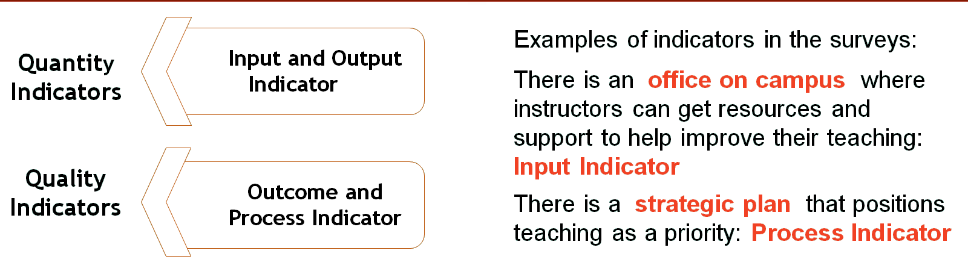
Use of Indicators on TCPS
Examining the perceived existence (agreement ratings) and importance (importance ratings) of certain indicators related to quality teaching to develop a profile of the culture in the institution.
Triangulation of perception and facts

Slide 17
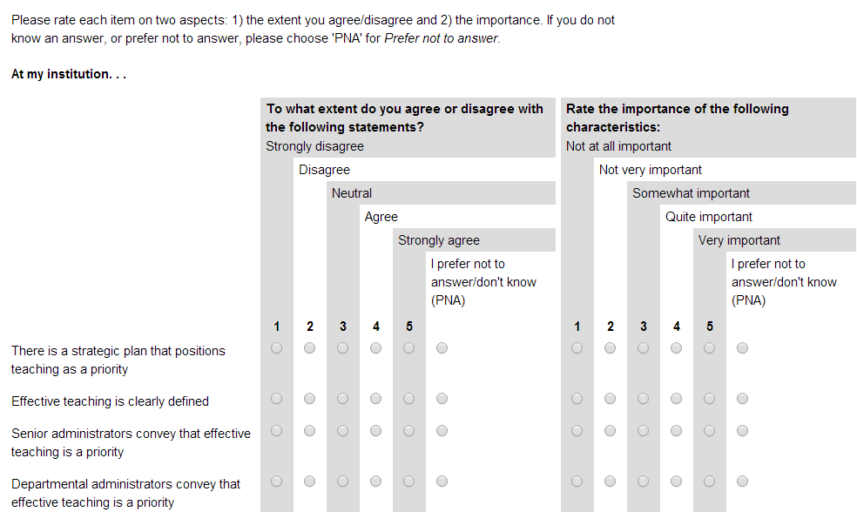
Teaching Culture Perception Survey (TCPS)
Assessment of agreement and importance ratings

Slide 18
Teaching Culture Perception Survey & Focus Groups
Three versions of the survey and focus groups
  Students: graduate and undergraduate
  Faculty and administrators
  Professional Staff (new this year)
Piloted 2 surveys
  Windsor ( 921 participants)
  Western (1589 participants)
  McMaster (1334 participants)
Revised surveys added Staff version
  Queen’s (just completed)
Faculty & Administration

Slide 19
Pilot Study Qualitative Results
Noted indicators of a teaching culture that values teaching:
Students
Faculty
Current and supported best practices
Professors’ behavior
Teacher accessibility
Valid assessment tools
Implementation of student feedback
Support for teaching
Recognition of teaching
Support for teaching
Recognition of teaching
Infrastructure
Research not above teaching
Teaching evaluations
Notes:
Comments and examples for each point

Slide 20
Next Steps…
Received Social Science and Humanities Research Council (SSHRC) Grant
Validate and establish norms for the surveys
Expand focus of research (e.g., outside Ontario, include colleges)
Develop manual with recommendations to improve institutional teaching cultures
Notes:
The overall project is an important long term change management opportunity. Following completion of the formal proposed project, we plan to continue with focus groups to assess the face validity of the QCPI tool and indicators and to gather feedback about the process and utility of the report received. This portion of the project will be funded through other sources and in kind support.
Erika 30 secs

Slide 21
Conclusions…
  Project goal is to foster institutional cultures that value quality teaching, leading to improved teaching and learning
  Long term goal is supporting change by helping institutions to evaluate their teaching culture and use strategies to engage in continual enhancement
Notes:
The overall project is an important long term change management opportunity. Following completion of the formal proposed project, we plan to continue with focus groups to assess the face validity of the QCPI tool and indicators and to gather feedback about the process and utility of the report received. This portion of the project will be funded through other sources and in kind support.
Erika 30 secs

Slide 22
Research team
Paola Borin (Ryerson University)
Deb Dawson and Ken Meadows (University of Western Ontario)
Donna Ellis (University of Waterloo)
Lori Goff (McMaster University)
Jill Grose (Brock University)
Sandy Hughes and Joseph Beer (Laurier University)
Erika Kustra (University of Windsor)
Lynn Taylor (University of Calgary)
Peter Wolf (Queens University, previously University of Guelp)
Florida Doci (Project Coordinator, graduate, University of Windsor)
Student Research Assistants
Acknowledgement: MTCU Productivity Innovation Fund grant

Slide 23
References
  Berger, J.B. & Braxton, J.M. (1998). Revising Tinto’s interactionalist theory of student departure through theory elaboration: Examining the role of organizational attributes in the persistence process. Research in Higher Education, 39(2), 103–119.
  Burke, J. C. (1998). Performance Funding Indicators: Concerns, Values, and Models for State Colleges and Universities. New Directions for Institutional Research, 97, 49-60.
Chalmers, D. (2008). Teaching and Learning Quality Indicators in Australian Universities, Conference proceedings of Institutional Management in Higher Education (IMHE), Paris France, September 8-12.
Chalmers, D. & Thomson, K. (2008). Snapshot of Teaching and Learning Practice in Australian Higher Education Institutions. Carrick Institute for Learning and Teaching in Higher Education Ltd, Sydney, NSW.
Cox, B.E., McIntosh, K.L., Reason, R.D., & Terenzini, P.T. (2011). A culture of teaching: Policy, perception, and practice in higher education. Research in Higher Education, 52(8), 808–829.
Denison, D. R. (1996). What is the Difference Between Organizational Culture and Organizational Climate? A Native’s Point of View on a Decade of Paradigm Wars. Academy of Management Review, 21(3), 619-54.

Slide 24
References
Grayson, J.P. & Grayson, K. (2003). Research on retention and attrition (No. 6). Montreal: The Canada Millennium Scholarship Foundation.
Hénard, F. & Roseveare, D. (2012). Fostering Quality Teaching in Higher Education: Policies and Practices. France: Organization for Economic Co-operation and Development. http://www.oecd.org/edu/imhe/QT%20policies%20and%20practices.pdf
Kustra, E., Doci, F., Gillard, K., Discke Hondzel, C., Goff, L., Gabay, D., Meadows, K., N., Borin, P., Wolf, P., Ellis, D., Eiliat, H., Grose, J., Dawson, D., & Hughes, S. (2015). Teaching Culture Perception: Documenting and Transforming Institutional Teaching Cultures. Collected Essays on Learning and Teaching. 8, 231-244. http://celt.uwindsor.ca/ojs/leddy/index.php/CELT/article/view/4267
Kustra, E., Doci, F., Meadows, K., N., Dawon, D., Dishke Honzel, C., Goff, L., Gabay, D., Wolf, P., Ellis, D., Grose, J., Borin, P., & Hughes, S. (2014). Teaching culture indicators: Enhancing quality teaching. Report to the Ministry of Training, Colleges and Universities Productivity and Innovation Fund Program, University of Windsor, Ontario. http://scholar.uwindsor.ca/ctlreports/5/
Warglien, M., & Savoia, M. (2001). Institutional Experiences of Quality Assessment in Higher Education -The University of Venice (Italy). Organization for Economic Cooperation and Development (OECD).

Slide 25
Erika Kustra: kustraed@uwindsor.ca
Website: uwindsor.ca/teachingculture
QUESTIONS
Notes:
ADD Calgary image
Add link to MTCU Report
Time

