Slide 1









Documenting and Transforming Institutional Teaching Cultures
Paola Borin
Deb Dawson
Florida Doci
Donna Ellis
Lori Goff
Jill Grose
Sandy Hughes
Erika Kustra
Peter Wolf
STLHE – June 2014
Notes:
EK

Slide 2
Session Overview
Provide background on our project about how teaching is valued at universities – the teaching culture
Share highlights of results to date from our pilot study involving surveys and focus groups
Discuss possible indicators of teaching culture

Slide 3
The Political Terrain
in Ontario
Metrics, metrics, metrics
Productivity and Innovation
Strengthening
centres of creativity innovation and knowledge
Differentiation
Strategic Mandates
Notes:
What we’re up against in Ontario

Slide 4
The value that institutions
place on teaching is
important to us
The value that institutions
place on teaching is
important to us
We aim to contribute to fostering an
institutional culture that values quality teaching
Notes:
Fundamental premises behind our work
Lori [from EDC session]
With this slide shown, we can mention that we’ve been creating a survey that will help us understand and document the culture (or the perceptions, beliefs, and behaviours that people within an institution have) and how extensively (quality) teaching is valued.
Then, we can transition into why this is important within the political terrain in Ontario.

Slide 5
What do we mean by teaching culture?
Organizational culture = Deep structure of an organization, rooted in organizational members’ values, beliefs, and assumptions (Denison, 1996)
We believe that one fundamental way to ensure quality teaching is to foster an institutional culture that values teaching
Notes:
Assumptions [from EDC session]
In higher education, organizational behaviour theory suggests that professors’ behaviors will reflect their institutional and departmental culture, which implies that improving the culture of teaching will have an effect on student experience (Cox, McIntosh, Reason & Terenzini, 2011). There is evidence to suggest that organizational culture positively influences outcomes such as student persistence (Berger & Braxton, 1998; Berger & Milem, 2000).
FROM ORIGINAL SLIDE: A quality teaching culture, as we attempt to define it, is the set of institutional perceptions, behaviours, and norms that suggest quality teaching is valued
Erika

Slide 6

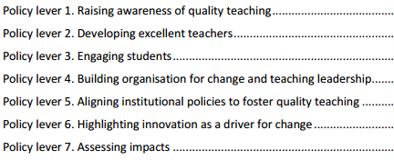
Teaching Culture – Initial Elements
Teaching is recognized in strategic initiatives and practices
Assessment of teaching is constructive and flexible
Faculty are encouraged to develop as teachers
Infrastructure exists to support teaching
Broad engagement around teaching occurs
http://www.oecd.org/edu/imhe/QT%20policies%20and%20practices.pdf

Slide 7
Our Project Aims
Understand and document institutional teaching culture and how extensively teaching is valued
Raise the profile and importance of teaching in Ontario universities
Shift the way institutions, faculty, and staff think about teaching
Influence some of the metrics used to measure teaching and its value or importance
Notes:
CUT from slide: Increase the valuing of teaching and levers to improve culture

Slide 8
Overall Project Focus
Evidence & enhance
institutional teaching culture
at Ontario universities
    through
  direct feedback from constituents
    and
    key institutional indicators
    in order to
    provide concrete feedback and recommendations for continuous improvement
Notes:
[from EDC session]
The focus for this project is the value an institutional culture places on quality teaching. Improved organizational culture is tied to increases in productivity, performance, commitment and satisfaction in evidence drawn from the Business and Organizational Change Management literature (Barney, 1986; Saffold, 1988; Schein, 1992; Cameron & Quinn, 1999; Lok & Crawford, 2004). While culture contributes to the success of an organization, not all dimensions contribute equally (Denison, Daniel & Haaland, 2004). Labor cost advantages can be found in organizations with clearly codified cultures through becoming well known as more desirable places to work (Heskett, Sasser, & Wheeler, 2008). Attraction to the culture and structure of an organization is at the root of managing employee retention (Sheridan, 1992). Further, because turnover of faculty in higher education is likely much more costly than that of employees in the corporate environment due to institutional investment in start-up costs (i.e. laboratories), it is desirable to retain highly productive academics. Such a focus on retaining newly recruited faculty will contribute to a cycle of excellent research outputs and teaching excellence (Simmons, 2002).
Organizations with engaged workforces tend to have higher retention rates, increased customer satisfaction, and are more financially productive and profitable (Harter, Schmidt & Keyes, 2002). Engagement mediates the relationship between culture and performance, as is also suggested in the literature on student engagement (Skinner, Wellborn & Connell, 1990).
Pb

Slide 9
Anticipated Project Outcomes
Develop a survey instrument that identifies and provides evidence of prevailing perceptions regarding the teaching culture among key stakeholders – the Teaching Culture Perception Survey (TCPS)
Identify key institutional indicators to triangulate and confirm teaching culture
Develop a report template that institutions would receive following the completion of the inventory
Develop a recommendation package to help institutions choose practices that enhance their teaching culture
Notes:
Pb

Slide 10
The Consultative Process
Presented to EDC for feedback (winter 2013)
Shared idea with Council of Ontario Universities (summer 2013)
Applied for Government funds (MTCU-PIF; fall 2013) – received $175,000
Presented to Council of Ontario Educational Developers for feedback (fall 2013)
Updated COU; requested support (fall 2013)
Updated EDC on project progress (winter 2014)

Slide 11
Project Phases
Phase 1:
Develop & pilot the Teaching Culture Perception Survey (TCPS) with educators, administrators and students at three Ontario universities – refine TCPS as needed
Phase 2:
Develop institutional Teaching Culture Indicators to validate & triangulate the perception based indicators and provide additional data about culture
Phase 3:
Develop reports and recommendations to accompany the results returned to participating institutions
Notes:
DE: Either this slide or slide 9 should be removed as they say the same basic thing

Slide 12
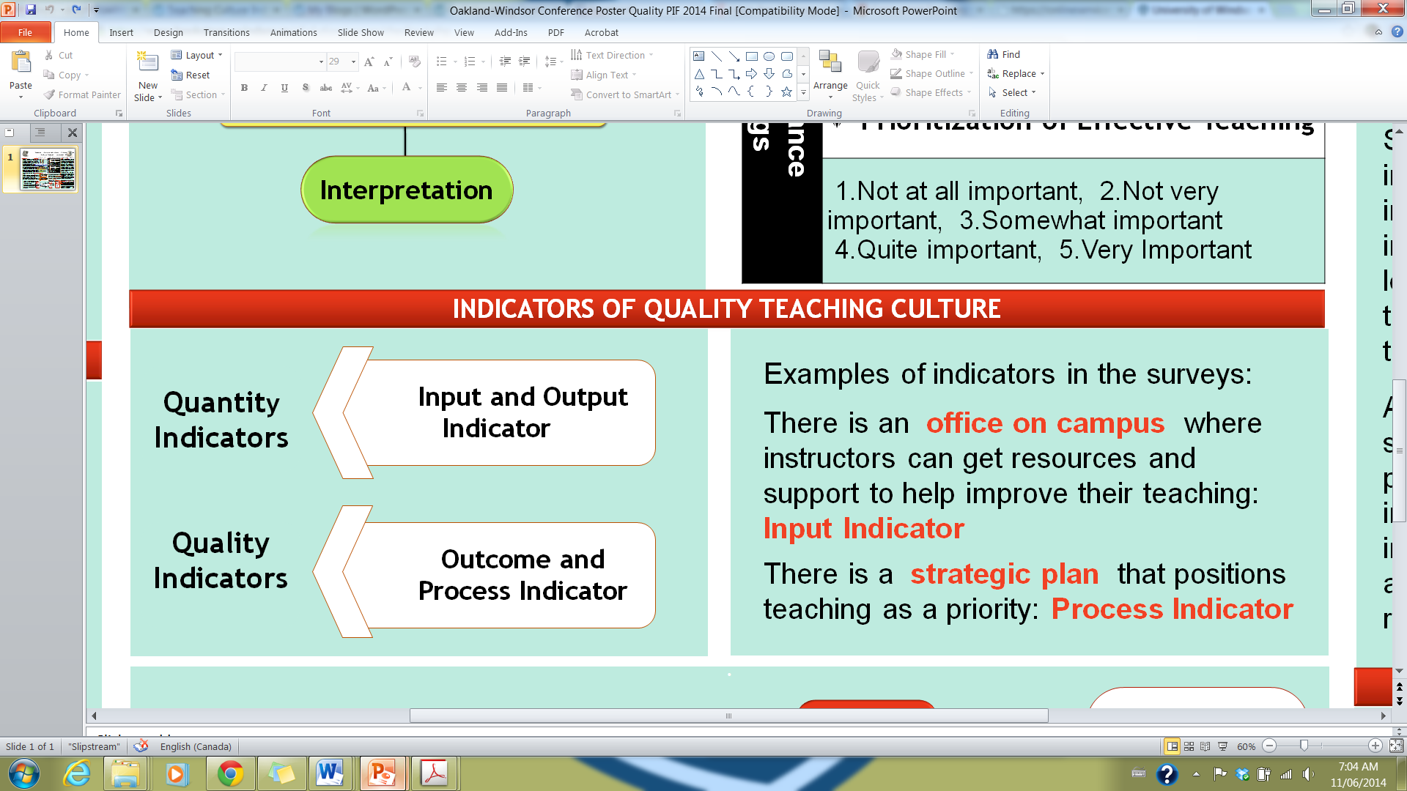
Phase 1 – Pilot Study – Teaching Culture Perception Survey
Aimed at examining the perceptions to develop a profile, allowing comparison between different stakeholders’ perceptions & comparison of change over time.
Questions designed to identify and validate indicators of quality teaching culture on campus.
Indicators are signals that reveal the progress or lack of progress towards a specific objective. (Chalmers 2008)

Slide 13
Phase 1 – Pilot Study – Identification and validation of indicators
Input: Resources involved in supporting an institutional program, activity or service.
Output: Reflect the quantity of outcomes, including measurable results and direct consequences of the activities implemented. (Bruke 1998)
Outcome: Focus on the quality of educational program, activity and service benefits for all stakeholders. (Warglien & Savoia 2001)
Process: Means used to deliver educational programs, activities and services within the institutional environment. (Bruke 1998)
Notes:
Input: Enrollment rates, resources & infrastructure, support services, expenditures etc
Output: Retention rate, success rate, graduation rate, graduate full-time employment etc
Outcome: Graduate satisfaction, employer satisfaction, graduate competencies, learning outcomes, student literacy level etc
Process: Student experience, professional development, teaching and learning plans and policies, appointment and promotion criteria, assessment and feedback policies etc

Slide 14
Phase 1 –Indicators
Examining the perceived existence (agreement ratings) and importance (importance ratings) of certain indicators related to quality teaching to develop a profile of the culture in the institution.
Triangulation of perception and facts to determine deviation from actual facts.
Identification of other indicators that speak to the culture of quality teaching.

Slide 15
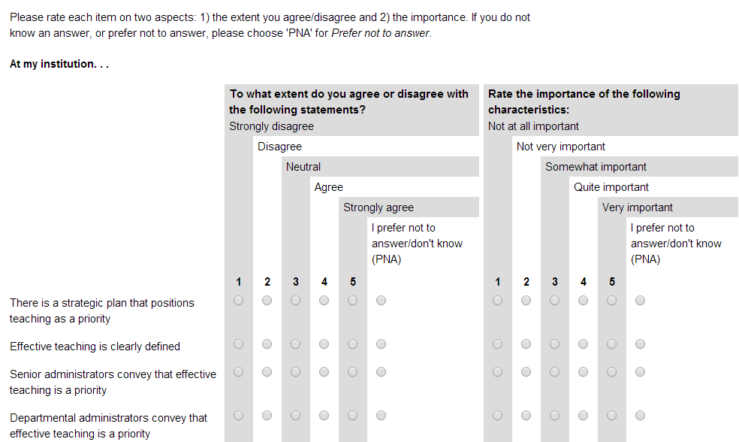
Phase 1 – Pilot Study – Teaching Culture Perception Survey & Focus Groups
Assessment of agreement and importance ratings

Slide 16
Phase 1 – Pilot Study – Teaching Culture Perception Survey & Focus Groups
Two versions of the survey
  Students: Graduate & undergraduate
  Faculty & Administration
Pilot survey at three Ontarian institutions
  Windsor ( 921 participants)
  Western (1589 participants)
  McMaster (1334 participants)
Focus groups ran to collect feedback
on the survey and input on quality
teaching culture at each institution.
Faculty & Administration

Slide 17
Pilot Study Quantitative Results
 | Agreement | Importance
Faculty | 1) Encouraging effective teaching (.92) | 1) Encouraging effective teaching (.94)
 | 2) Broad involvement around teaching (.88) | 2) Recognizing effective teaching (.90).
 | 3) Recognizing effective teaching (.73) | 3) Assessing teaching (.89)
 | 4) Assessing teaching (.78)
Undergraduate Students | 1) Implementing effective Teaching (.93) | 1) Implementing effective teaching (.79)
 | 2) Accessing infrastructure (.85) | 2) Broad involvement around teaching (.85)
 | 3) Broad involvement around teaching (.89) | 3) Accessing infrastructure (.84)
 | 4) Recognizing effective teaching (.71) | 4) Recognizing effective teaching (.80)
 |  | 5) Providing feedback on teaching (.83)
 |  | 6) Prioritizing effective teaching (.78)
Graduate Students | 1) Fostering and implementing effective teaching (.95) | 1) Implementing and enhancing effective teaching (.91)
 | 2) Accessing infrastructure (.86) | 2) Broad involvement around teaching (.87)
 | 3) Recognizing effective teaching (.77) | 3) Accessing infrastructure (.86)
 |  | 4) Recognizing effective teaching (.78)
Notes:
2) Summary of differences for the factors ‘
a) Faculty:
Gender
Agreement: There were no gender differences.
Importance: Female faculty members rated all of the importance as more important than their male counterparts.
Appointment
Agreement: Contract/Sessional faculty agreed significantly less that their institution recognized effective teaching than their Tenured and Tenure Track colleagues.
Importance: Tenured faculty members rated all three of the importance subscales as of lesser importance than their Tenure Track and Contract/Sessional colleagues.
Years of Teaching Experience
Agreement: There were no significant differences based on the years of teaching experience.
Importance: There were significant differences for both the Support for Effective Teaching and Assessment of Teaching subscales such that faculty with 0-9 years experience rated both as more important than their colleagues with 10-19 and 20+ years of teaching experience.
Institution
Agreement: McMaster rated their agreement on the Assessment of Teaching significantly higher than their Western and Windsor counterparts (who did not differ than one another).
Importance: Western rated Support for Effective Teaching as less important than their colleagues from Windsor. Western faculty also rated Assessment of Teaching as less important than their colleagues from Windsor and McMaster.
b) Undergraduate students:
Gender
Agreement: Female undergraduate students agreed significantly more than their male counterparts that their institutions recognized effective teaching
Importance: Female undergraduate students rated Engaged Teaching, Access to Infrastructure, Recognition for Effective Teaching, Prioritization of Effective as more important than the men.
Program Year
Agreement: There were no significant differences based on the students’ year of program.
Importance: There were also no significant differences.
Institution
Agreement: For the undergraduate students at Windsor, their agreement on Effective Teaching, Access to Infrastructure, Support from Stakeholders, and Recognition for Effective Teaching was significantly lower than their Western and McMaster counterparts. Western and McMaster did not differ significantly.
Importance: There were no institutional differences.
b) Graduate students:
Gender
Agreement: There were no gender differences.
Importance: Female graduate students rated Effective Teaching and Recognition for Effective Teaching as more important than did their male counterparts.
Degree
Agreement: Master’s students agreed significantly more than PhD students that Effective Teaching, Access to Infrastructure, and Recognition for Effective Teaching was evident at their institutions.
Importance: Masters students rated Effective Teaching and Support from Stakeholder as more important than did their PhD counterparts.
Domestic or Internal Status
Agreement: International graduate students agreed significantly more that Effective Teaching, Access to Infrastructure, and Recognition for Effective Teaching were evident at their institutions than their domestic counterparts.
Importance: International graduate students rated the importance of Support for Stakeholders more highly than did their domestic colleagues.
Institution
Agreement: There were no institutional differences.
Importance: Windsor graduate students rated support from stakeholders as significantly more important than graduate students at Western or Windsor.
Semesters of being a TA or GA
Agreement: Less experienced TAs (0-2 semesters) agreed significantly more that Effective Teaching, Access to Infrastructure, and Recognition for Effective Teaching were evident at their institutions than their more experienced counterparts (3+ semesters).
Importance: TAs with 2 or fewer semesters experience as a TA rated effective teaching and support from stakeholders as more important than their colleagues who have been TAs for 3 or more semesters.

Slide 18
Pilot Study Qualitative Results
Noted indicators of a teaching culture that values teaching:
Students:
Faculty:
Current and supported best practices
Professors’ behaviour
Passion
Teacher accessibility
Valid assessment tools
Implementation of student feedback
Promotional incentives for teaching
Support for teaching
Infrastructure
Research above teaching
Teaching evaluations
Notes:
Comments and examples for each point

Slide 19
Phase 2
Teaching Culture Institutional Indicators
Identify indicators that are available at the majority of Ontario institutions
Most highly correlated with or predictive of a teaching culture
____ Evidence of ‘course and curriculum improvement’ funds
____ Evidence of a well-developed strategic plan for enhancing the undergraduate learning experience
____ Evidence of senior leadership devoted to undergraduate teaching & learning
Notes:
Lori
2:10

Slide 20
Future work/Wrap up
Recognize the qualitative nature of studying culture
Focus groups
Other approaches to study institutional culture
Possibilities of expansion beyond Ontario
Notes:
The overall project is an important long term change management opportunity. Following completion of the formal proposed project, we plan to continue with focus groups to assess the face validity of the QCPI tool and indicators and to gather feedback about the process and utility of the report received. This portion of the project will be funded through other sources and in kind support.
Erika 30 secs

Slide 21
References
Burke, Joseph C. 1998. “Performance Funding Indicators: Concerns, Values, and Models for State Colleges and Universities.” New Directions for Institutional Research. (97): 49–60.
Chalmers, D. (2008)Teaching and Learning Quality Indicators in Australian Universities, Conference proceedings of Institutional Management in Higher Education (IMHE), Paris France, September 8-12.
Denison, D. R. “What is the difference between organizational culture and organizational climate? A native’s point of view on a decade of paradigm wars.” Academy of Management Review 21, no. 3 (July 1, 1996): 619–54.
Warglien, M., & Savoia, M. 2001. Institutional Experiences of Quality Assessment in Higher Education - The University of Venice (Italy). Organisation for Economic Cooperation and Development (OECD).
Notes:
The overall project is an important long term change management opportunity. Following completion of the formal proposed project, we plan to continue with focus groups to assess the face validity of the QCPI tool and indicators and to gather feedback about the process and utility of the report received. This portion of the project will be funded through other sources and in kind support.
Erika 30 secs

Slide 22
Thank you!

