Slide 1


Exchanging Practices that Drive Cultural Change in Higher Education
Lindsay Shaw, Academic Advisor & Research Coordinator, Brock University
Dr. Jill Grose, Director, Centre for Pedagogical Innovation, Brock University
Dr. Erika Kustra, Director, Centre for Teaching and Learning, University of Windsor
Collaborating Partners: Dr. Lori Goff, Dr. Donna Ellis, Dr. Kristin Brown, Dr. Joseph Beer, Dr. Lynn Taylor, Dr. Debra Dawson, Dr. Ken Meadows, Peter Wolf and Dr. Paola Borin.

Slide 2
1. Introduction: Teaching Culture Project
2. Purpose: The Repository
3. Current State: The Repository
4. Exchange of Practice
5. Cultural Implications of the Practices
6. Opportunity to Submit a Practice
Outline

Slide 3
Teaching Culture is the product of a dynamic interplay among the embedded patterns, behaviours, values, beliefs and ideologies about teaching and learning that exist within and across the many microcultures that make up a contemporary university.
(Cox et al., 2011; Kustra et al. 2014; Mårtensson & Roxå, 2016).
Teaching Culture can impact critical outcomes such as:
Student Engagement
(Grayson & Grayson, 2003)
Student Learning
(Cox et al., 2011)
Student Retention
(Cox et al., 2011)
Faculty Motivation
(Feldman & Paulsen, 1999)
Staff Productivity
(Harter et al, 2003; Lok & Crawford, 2004)
This project was supported by an Educational Developers Caucus Grant of the Society for Teaching and Learning in Higher Education.

Slide 4
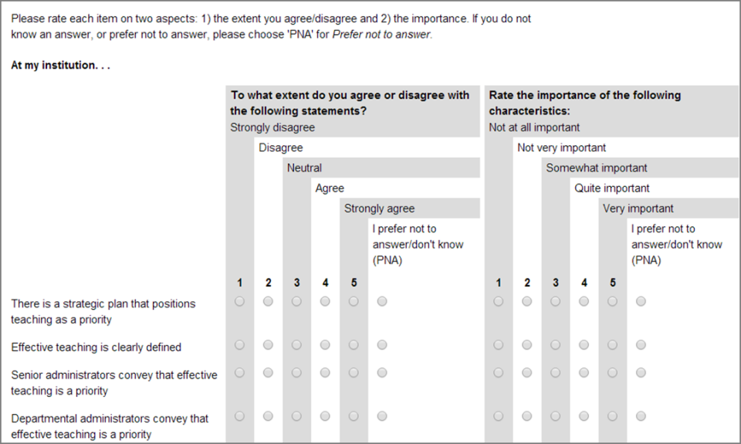
Teaching Culture Project Overview
A group of educational researchers developed a set of three Institutional Teaching Culture Perception Surveys (ITCPS) to capture a snapshot of teaching culture in a particular time frame, providing institutions with feedback on six levers (Hénard & Roseveare, 2012; Kustra et al., 2014).
The surveys gather perceptions from staff, faculty and students.
In 2016-18 surveys were released in two phases at 7 institutions across Canada funded by a SSHRC Insight Development Grant.
Analysis and validation of surveys is on-going.
To read more about the project and other presentations, visit our website: https://qualityteachingculture.wordpress.com/

Slide 5
1. Institutional Strategic Documents and Initiatives Prioritize Effective Teaching
(Association of American Universities, 2013; Gibbs et al., 2008)
Teaching is considered a priority in the strategic plan, effective teaching is clearly defined in institution-wide documents, senior administrators convey that teaching is a priority etc.
2. Assessment of Teaching is Constructive and Flexible
(Arreola, 2007; Kaplan, 2018; Wright et al., 2014)
Students are invited to provide feedback, student evaluations are taken into consideration in hiring promotion and tenure, instructors have some influence over how teaching is assessed, etc.
4. Infrastructure Exists to Support Teaching
(Finkelstein et al., 2016; Jamieson, 2003)
Instructors adopt a wide variety of approaches to teaching and learning, instructors are encouraged to use evidence to inform teaching, instructors access services and resources etc.
3. Effective Teaching is Implemented
(Jawitz & Perez, 2016; Riddell & Haigh, 2015)
5. Broad Engagement Occurs Around Teaching
(Jawitz & Perez, 2016; Williams et al., 2013)
Learning spaces are designed to support learning, instructors have access to resources, instructors can get financial support, instructors use technology to support student learning etc.
6. Effective Teaching is Recognized and Rewarded
(Dennin et al., 2017)
Students are involved in activities that foster effective teaching, external stakeholders are involved in initiatives, teaching practices are discussed across the institution etc.
There are institutional rewards, teaching accomplishments are publicized, teaching is valued in the hiring process, there is institutional recognition for staff who support teaching etc.
Levers
(Hénard & Roseveare, 2012;
Kustra et al., 2014)
This project was supported by an Educational Developers Caucus Grant of the Society for Teaching and Learning in Higher Education.

Slide 6
Facilitated Conversation: Part 1
What kind of teaching culture do you see at your institution?

Slide 7
The Repository Overview
Designed as a companion resource to the ITCP surveys.
Provide ideas for how we might strengthen a particular lever to enhance teaching culture.
Practices were gathered through listservs, conference presentations and word-of-mouth requests.
Some of the practices identified will have been formally assessed for their impact; some are applications of established theory or research evidence; while others represent the wisdom of practice developed in an individual institution or discipline.
Practices will be relevant to enhancing more than one lever.
Open to multiple applications and adaptations, depending on local context.
The repository is expected to be released in September 2019.
Guiding Principles
Teaching Culture Matters
Focus on Learning
Context Matters
Collaboration
This project was supported by an Educational Developers Caucus Grant of the Society for Teaching and Learning in Higher Education.

Slide 8
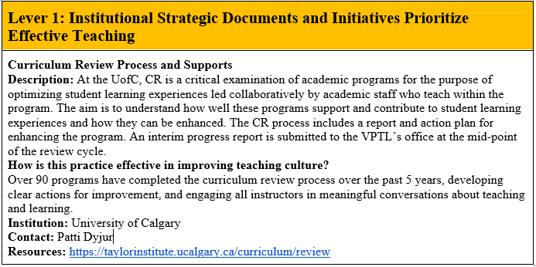
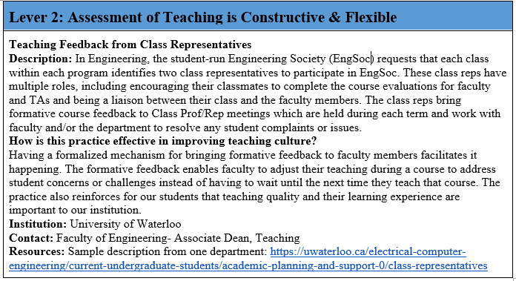
Repository
Examples
This project was supported by an Educational Developers Caucus Grant of the Society for Teaching and Learning in Higher Education.

Slide 9
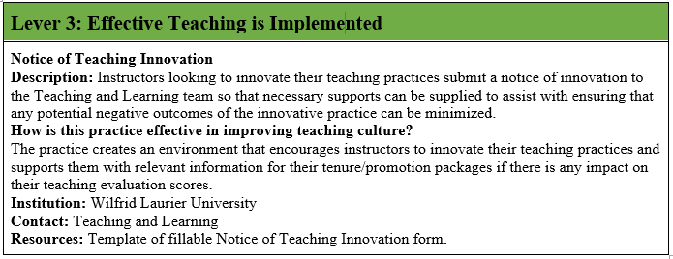
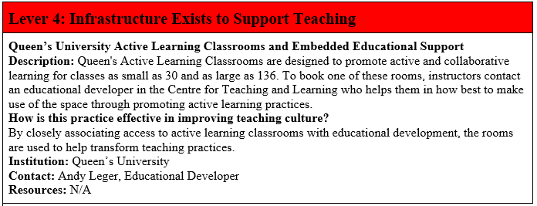
Repository
Examples
This project was supported by an Educational Developers Caucus Grant of the Society for Teaching and Learning in Higher Education.

Slide 10
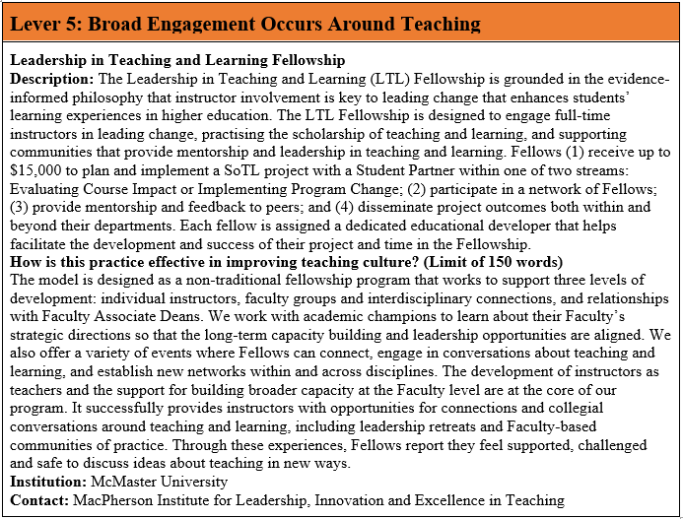
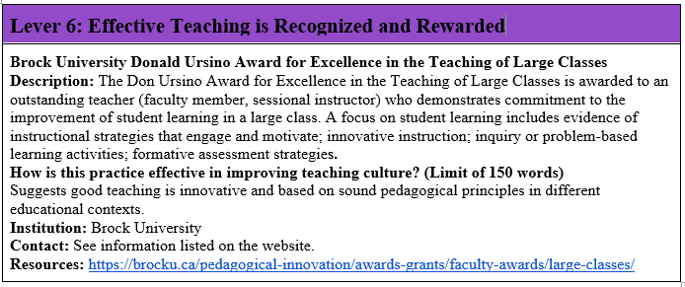
Repository
Examples
This project was supported by an Educational Developers Caucus Grant of the Society for Teaching and Learning in Higher Education.

Slide 11
Facilitated Conversation: Part 2
Are there practices at your institution that you think contribute to a positive teaching culture?
This project was supported by an Educational Developers Caucus Grant of the Society for Teaching and Learning in Higher Education.

Slide 12
Facilitated Conversation: Part 3
How might this online repository benefit your work?
This project was supported by an Educational Developers Caucus Grant of the Society for Teaching and Learning in Higher Education.

Slide 13
Opportunity to Participate in the Repository
Repository Form: https://uwindsor.ca1.qualtrics.com/jfe/form/SV_5alM43PUjutgi8J
Alternative Location: https://qualityteachingculture.wordpress.com/effective-practices-repository/
Paper Forms Also Available*
This project was supported by an Educational Developers Caucus Grant of the Society for Teaching and Learning in Higher Education.

Slide 14
Lindsay Shaw, MA
Project Coordinator, Brock University
lshaw2@brocku.ca
Erika Kustra, PhD
Project Lead, Teaching Culture Indicators (Larger Project)
Director, Centre for Teaching and Learning, University of Windsor
kustraed@uwindsor.ca
Jill Grose, PhD
Project Lead, Repository of Effective Practices (Sub Project)
Director, Centre for Pedagogical Innovation, Brock University
jgrose@brocku.ca
Contacts
This project was supported by an Educational Developers Caucus Grant of the Society for Teaching and Learning in Higher Education.

Slide 15
References
Association of American Universities. (2013). Framework for systemic change in undergraduate STEM teaching and learning. Retrieved from: https://www.aau.edu/sites/default/files/STEM%20Scholarship/AAU_Framework.pdf
Arreola, R. A. (2007). Developing a comprehensive faculty evaluation system: A guide to designing, building, and operating large-scale faculty evaluation systems (3rd ed.). Bolton, MA: Anker.
Cox, B.E., McIntosh, K.L., Reason, R.D., & Terenzini, P.T. (2011). A culture of teaching: Policy, perception, and practice in Higher Education. Research in Higher Education, 52, 808-829.
Dennin, M., Schultz, Z.D., Feig, A., Finkelstein, N., Greenhoot, A.F., Hildreth, M.,…Miller, E.R. (2017). Aligning practice to policies: Changing the culture to recognize and reward teaching at research universities. CBE- Life Sciences Education, 16(5), 1-8. https://doi.org/10.1187/cbe.17-02-0032
Finkelstein, A., Ferris, J. Weston, C., & Winer, L. (2016). Research-informed principles for (re)designing teaching and learning spaces. Journal of Learning Spaces, 5(1), 26-40. Retrieved from http://libjournal.uncg.edu/jls/article/view/1213/909
Gibbs, G., Habeshaw, T., & Yorke, M. (2000). Institutional learning and teaching strategies in English higher education. Higher Education, 40, 351-372. https://doi.org/10.1023/A:1004148310182
Gibbs, G., Knapper, C., & Piccinin, S. (2008). Disciplinary and contextually appropriate approaches to leadership of teaching in research-intensive academic departments in higher education. Higher Education Quarterly, 62(4), 416-436. https://doi.org/10.1111/j.1468-2273.2008.00402.x
Ginsberg, S.M., & Bernstein, J.L. (2011). Growing the scholarship of teaching and learning through institutional culture change. Journal of Scholarship of Teaching and Learning, 11, 1-12.
Grayson, J.P., & Grayson, K. (2003). Research on retention and attrition (No. 6). Montreal QC: The Canadian Millennium Scholarship Foundation.
Harter, J.K., Schmidt, F.L., & Keyes, C. L. (2003). Well-being in the workplace and its relationship to business outcomes: A review of the Gallup studies. In C.L.M. Keyes & J. Haidt (Eds.), Flourishing: The positive person and the good life (pp. 205–224).
Hénard, Fabrice, and Deborah Roseveare. “Fostering quality teaching in higher education: Policies and Practices.” An IMHE Guide for Higher Education Institutions (2012): 7-11.
Jamieson, P. (2003). Designing more effective on-campus teaching and learning spaces: A role for academic developers. The International Journal for Academic Development, 8(1), 119-133.
Jawitz, J. & Perez, T. (2016). Investing in teaching development: Navigating risk in a research intensive institution. International Journal for Academic Development, 21(3), 194-205. https://doi.org/10.1080/1360144X.2015.1081852
Kustra, E., Doci, F., Gillard, K., Discke-Hondzel, C., Goff, L., Gabay, D.,…& Hughes, S. (2015). Teaching culture perception: documenting and transforming institutional teaching cultures. Collected Essays on Learning and Teaching: Transforming Our Learning Experiences, 8, 231-244.
Kustra, E., Doci, F., Meadows, K.N., Dawson, D., Dishke-Honzel, C., Goff, L.,…Hughes, S. (2014). Teaching culture indicators: Enhancing quality teaching. Report to the Ministry of Training, Colleges and Universities Productivity and Innovation Fund Program, University of Windsor, ON.
Lok, P., & Crawford, J. (2004). The effect of organisational culture and leadership style on job satisfaction and organisational commitment: A cross-national comparison. Journal of Management Development, 23(4), 321-338. https://doi.org/10.1108/02621710410529785
Kaplan, W. (2018). In the matter of an interest arbitration. Retrieved from: https://www.canlii.org/en/on/onla/doc/2018/2018canlii58446/2018canlii58446.html.
Mårtensson, K., & Roxå, T. (2016). Leadership at a local level- enhancing educational development. Educational Management Administration and Leadership, 44(2), 247. 262. https://doi.org/10.1177/1741143214549977
Miller-Young, J.E., Anderson, C., Kiceniuk, D., Mooney, J., Riddell, J., Schmidt Handbidge, A.,…Chick, N. (2017). Leading up in the scholarship of teaching and learning. The Canadian Journal for the Scholarship of Teaching and Learning, 8(2). https://doi.org/10.5206/cjsotl-rcacea.2017.2.4
Rawn, C., & Fox, J.A. (2018). Understanding the work and perceptions of teaching focused faculty in a changing academic landscape. Research in Higher Education, 59(5), 591- 622. https://doi.org/10.1007/s11162-017-9479-6
Riddell, J., & Haigh, C.A. (2015). Preaching what we practice: How institutional culture supports quality teaching. Journal of Eastern Township Studies, 44, 15-33.
Shaw, L., Brown, K., Ellis, D., Wolf, P., Dawson, D., & Kustra, E. (in press). From perception to practice: A qualitative exploration into institutional teaching culture. Collected Essays on Learning and Teaching.
Stensaker, Bjorn. (2017). Academic development as cultural work: responding to the organizational complexity of modern higher education institutions. International Journal for Academic Development, 23(4), 274-285.
Williams, A.L., Verwoord, R., Beery, T.A., Dalton, H., McKinnon, J., Strickland, K.,…Poole, G. (2013). The power of social networks: A model for weaving the scholarship of teaching and learning into institutional culture. Teaching and Learning Inquiry: The ISSOTL Journal, 1(2), 49-62. https://doi.org/10.20343/teachlearninqu.1.2.49
Wright, W.A., Mighty, J., Muirhead, B., Scott, J., & Hamilton, B. (2014). The Ontario Universities’ teaching evaluation toolkit: A feasibility study. Report to the Ministry of Training, Colleges and Universities – Productivity and Innovation Fund Program. University of Windsor: Windsor, ON.

