Slide 1









Perceptions and indicators of an institutional culture that values teaching
Paola Borin
Deb Dawson
Donna Ellis
Lori Goff
Jill Grose
Sandy Hughes
Erika Kustra
Peter Wolf
Notes:
EK

Slide 2
The value that institutions
place on teaching is
important to us
The value that institutions
place on teaching is
important to us
We aim to foster an
institutional culture that values
quality teaching
Notes:
With this slide shown, we can mention that we’ve been creating a survey that will help us understand and document the culture (or the perceptions, beliefs, and behaviours that people within an institution have) and how extensively (quality) teaching is valued.
Then, we can transition into why this is important within the political terrain in Ontario.
Lori

Slide 3
The political terrain
in Ontario
Metrics, metrics, metrics
Productivity and Innovation
Strengthening
centres of creativity innovation and knowledge
Differentiation
Strategic Mandates
Notes:
Here, I was thinking that we could mention (without going into much detail) some of the political movements in Ontario as a primer for the sorts of things we want them to discuss in the next slide.
Pb

Slide 4
The political terrain
What political pressures and influences are affecting teaching and learning in your province?
Notes:
Group discussion
1:20 – 1:30
Discuss in dyads or triads

Slide 5
Ontario Differentiation Framework
Ministry of Training Colleges and Universities
Teaching and Learning: Program delivery methods, learning options for students, improved learning experience
Student population: Access, retention, success to PSE for underrepresented groups
Jobs, Innovation, and Economic Development: Collaborations with employers, community partners; local/global; social, economic development
Strategic Enrolment: Enrolment levels, growth, and future plans
Research: Institutional research activity
Program Offerings: Breadth of programming, enrolment and credentials offered
Institutional Collaboration: Credit transfer pathways, college/university collaborations
Sustainability: Institutional strategies to promote innovation and sustainability
Source: Ontario’s Proposed Differentiation Framework Draft Discussion paper - September 2013
Notes:
Back to Ontario – focusing now on the differentiation framework as one of the drivers and reasons why our work is important.
8 categories;
Lori

Slide 6
Ontario Differentiation Framework
Ministry of Training Colleges and Universities
Teaching and Learning
Description:
Strength in program delivery methods that: Expand learning options for students (Experiential learning, online learning, experiential learning, applied research) Improve the learning experiences Improve career preparedness
Proposed metrics include:
Satisfaction rates, KPI, NSSE results, # of teaching-only faculty, % of students in co-op
Source: Ontario’s Proposed Differentiation Framework Draft Discussion paper - September 2013
Notes:
More details about the teaching and learning component – now focus on the metrics they proposed and how we feel this could be broadened in scope to incorporate other indicators and perceptions.
Lori

Slide 7
Our interests
Raise the profile and importance of teaching in Ontario universities
Shift the way institutions, faculty and staff think about teaching
Increase the valuing of teaching and levers to improve culture
Influence some of the metrics used to measure the teaching and its value or importance
Notes:
1;35
Those are the provincial interests. Some measures worried us.
If we could measure something what might that be?
Culture is really important to us but
Metrics
. This slide is largely a repeat of why we’re doing our study, but summarizes it nicely.
Erika

Slide 8
What do we mean by culture?
We believe that one way to ensure quality teaching is to foster an institutional culture that values teaching
A quality teaching culture, as we attempt to define it, is the set of institutional perceptions, behaviours, and norms that suggest quality teaching is valued
Institutional Culture
Perceptions, behaviours, norms
Notes:
Assumptions
In higher education, organizational behaviour theory suggests that professors’ behaviors will reflect their institutional and departmental culture, which implies that improving the culture of teaching will have an effect on student experience (Cox, McIntosh, Reason & Terenzini, 2011). There is evidence to suggest that organizational culture positively influences outcomes such as student persistence (Berger & Braxton, 1998; Berger & Milem, 2000).
Erika

Slide 9
Project Focus
Evidence & enhance
institutional teaching culture
at Ontario universities
    through
  direct feedback from constituents
    and
    key institutional indicators
    in order to
    provide concrete feedback and recommendations for continuous improvement
Notes:
1:40
The focus for this project is the value an institutional culture places on quality teaching. Improved organizational culture is tied to increases in productivity, performance, commitment and satisfaction in evidence drawn from the Business and Organizational Change Management literature (Barney, 1986; Saffold, 1988; Schein, 1992; Cameron & Quinn, 1999; Lok & Crawford, 2004). While culture contributes to the success of an organization, not all dimensions contribute equally (Denison, Daniel & Haaland, 2004). Labor cost advantages can be found in organizations with clearly codified cultures through becoming well known as more desirable places to work (Heskett, Sasser, & Wheeler, 2008). Attraction to the culture and structure of an organization is at the root of managing employee retention (Sheridan, 1992). Further, because turnover of faculty in higher education is likely much more costly than that of employees in the corporate environment due to institutional investment in start-up costs (i.e. laboratories), it is desirable to retain highly productive academics. Such a focus on retaining newly recruited faculty will contribute to a cycle of excellent research outputs and teaching excellence (Simmons, 2002).
Organizations with engaged workforces tend to have higher retention rates, increased customer satisfaction, and are more financially productive and profitable (Harter, Schmidt & Keyes, 2002). Engagement mediates the relationship between culture and performance, as is also suggested in the literature on student engagement (Skinner, Wellborn & Connell, 1990).
Pb

Slide 10
Project Outcomes
Develop a survey instrument that identifies and provides evidence of prevailing perceptions regarding the teaching culture among key stakeholders - the Teaching Culture Perception Survey (TCPS)
Identify key institutional indicators to triangulate and confirm teaching culture (TCII)
Develop a report template that institutions would receive following the completion of the inventory
Develop a recommendation package to help institutions choose practices that enhance their teaching culture
Notes:
Pb

Slide 11
The consultative process
Presented to EDC for feedback (winter 2013)
Shared idea with Council of Ontario Universities (summer 2013)
Applied for Government funds (MTCU-PIF; fall 2013)
Presented to Council of Ontario Educational Developers for feedback (fall 2013)
Updated COU; requested support (fall 2013)
Updating EDC on project progress (winter 2014)
Notes:
1:45
Lori

Slide 12
Budget
Approximately $250,000, including contributions of approximately $90,000 of in-kind contributions for participating universities
Funding for:
  Project Coordinator
  Research Associates - 1 per each pilot institution x 3 institutions
  Undergraduate Research Assistants
  Recompense for survey participation
  Statistician consultations
  Online survey development
  Computers for research sites (1 per site)
  Travel for researchers
Government Funded (MTCU-PIF)
$175,000
Notes:
Lori

Slide 13

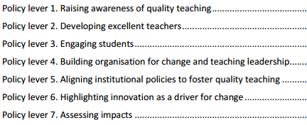
Teaching Culture - Levers
Teaching is recognized in strategic initiatives and practices
Assessment of teaching is constructive and flexible
Faculty are encouraged to develop as teachers
Infrastructure exists to support teaching
Broad engagement around teaching occurs
http://www.oecd.org/edu/imhe/QT%20policies%20and%20practices.pdf
Notes:
1:50
EK

Slide 14
Project Phases
Phase 1:
Develop & pilot the Teaching Culture Perception Survey (TCPS) with educators, administrators and students at three Ontario universities
Phase 2:
Develop institutional indicators, and Teaching Culture Institutional Indicators (TCII), to validate & triangulate the TCPS
Phase 3:
Develop reports and recommendations to accompany the results returned to participating institutions
Notes:
EK

Slide 15
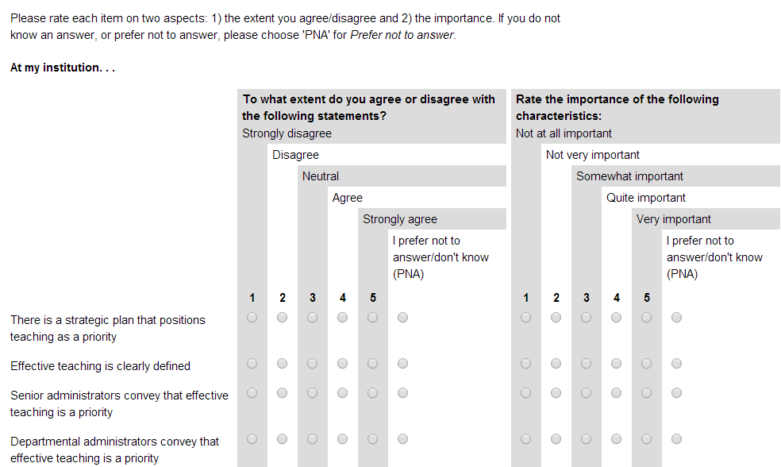
Phase 1
Teaching Culture Perception Survey
Aimed at examining the perceptions to develop a profile, allowing comparison between different stakeholders’ perceptions, & comparison of change over time.
Notes:
Hand out survey
What is on the screen is the way it will appear online
Goal over time is about enhancement and an institutions comparison to itself over time
Note:

Slide 16
Phase 1
Teaching Culture Perception Survey
Will this survey produce useful information?
Do these Levers make sense in identifying teaching culture?(Face Validity)
Are there any other issues or gaps you would like to raise?
Notes:
1:55 at the latest
Finish 2:10 at the latest
Form groups of 3 or four
10 mins to discuss
Focus on the first two and third if you have time.
Responses:
Pb

Slide 17
Phase 2
Teaching Culture Institutional Indicators
Identify indicators that are available at the majority of Ontario institutions
Most highly correlated with or predictive of a quality teaching culture
____ Evidence of ‘course and curriculum improvement’ funds
____ Evidence of a well-developed strategic plan for enhancing the undergraduate learning experience
____ Evidence of senior leadership devoted to undergraduate teaching & learning
Notes:
Lori
2:10

Slide 18
What other indicators might we consider?
What other metrics, measures, or markers might also provide an indication of an institutional culture that values teaching?
Notes:
Lori – ask plenary
Record responses on flip chart
2:10 - 3

Slide 19
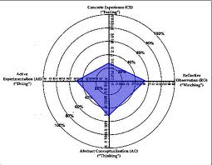
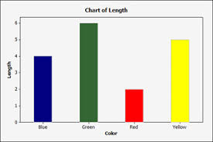
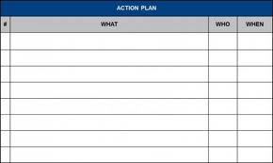
Phase 3
Report & Recommendations
Development of a report
distributed to participating institutions
  Provide the results from the
  TCPS & TCII
  Recommend best practices & provide examples that enable institutions to further enhance their teaching culture
Notes:
Erika 30 secs

Slide 20
Future work
Recognize the qualitative nature of studying culture
Focus groups
Other approaches to study institutional culture
Possibilities of expansion beyond Ontario
Notes:
The overall project is an important long term change management opportunity. Following completion of the formal proposed project, we plan to continue with focus groups to assess the face validity of the QCPI tool and indicators and to gather feedback about the process and utility of the report received. This portion of the project will be funded through other sources and in kind support.
Erika 30 secs

Slide 21
Thank you!

Slide 22
Project Timeline
a
2013 (January-August)
Review and revise categories
Develop draft of TCPI
Source additional funding (MTCU)
2014 (June-December)
Pilot & finalize TCII
Develop final version TCPI
Develop report template
a
a
2013/14 (September-June)
3 pilot institutions (McMaster, Western, Windsor)
Secure ethics clearance from pilot sites
Develop final draft of TCPI
Pilot survey & analyze results
Select most promising indicators – TCII
Develop instrument report template
2015
Refine TCPI and TCII
Pilot & finalize report template
Wide distribution across Ontario
Presentations & demonstrations
2012
Environmental Scan/Literature Review
Feedback from national community of practice
Conceptualize project

